Slide 1

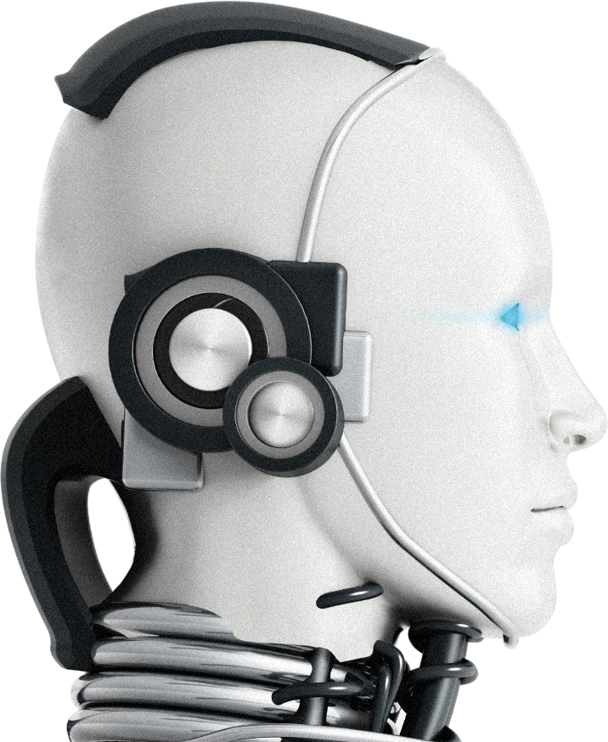
IntelliSafe
AI-Based Smart Campus Surveillance
An AI-powered smart campus surveillance MVP that combines YOLOv8 object detection, MediaPipe pose analysis
Start Slide

Slide 2



IntelliSafe
Problem statement
Campus physical safety remains a critical challenge
Manual CCTV monitoring:
Labor-intensive, inconsistent
High false-negative risk
Key gaps: unattended suspicious behavior, lack of predictive alerts

Slide 3

Artificial Intelligence
CEG Campus Issue
Recent incidents of sexual harassment and safety concerns, especially at night.
Limited CCTV coverage and delayed response from authorities.
Students fear reporting due to lack of anonymity.
Blind spots in surveillance and restricted area breaches are common.

Slide 4
IntelliSafe
Solution
Integrated AI Pipeline: YOLOv8 + MediaPipe + DeepSORT
Core Capabilities:
Unsafe behavior & object detection (no helmet, restricted zones)
Stalker detection via 20-frame persistence logic
Simulated hourly “drone” patrols over campus feeds
End-to-End Flow: Video Input → Edge AI Inference → Alert Service → Dashboard

Slide 5
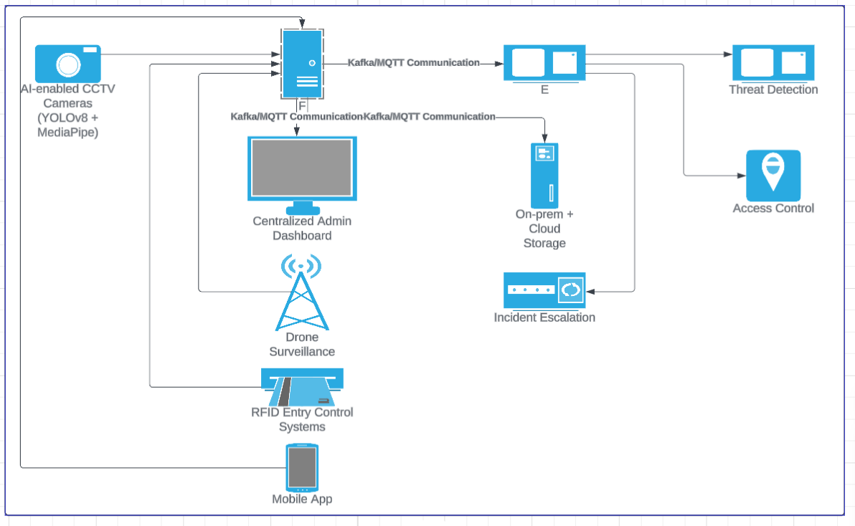
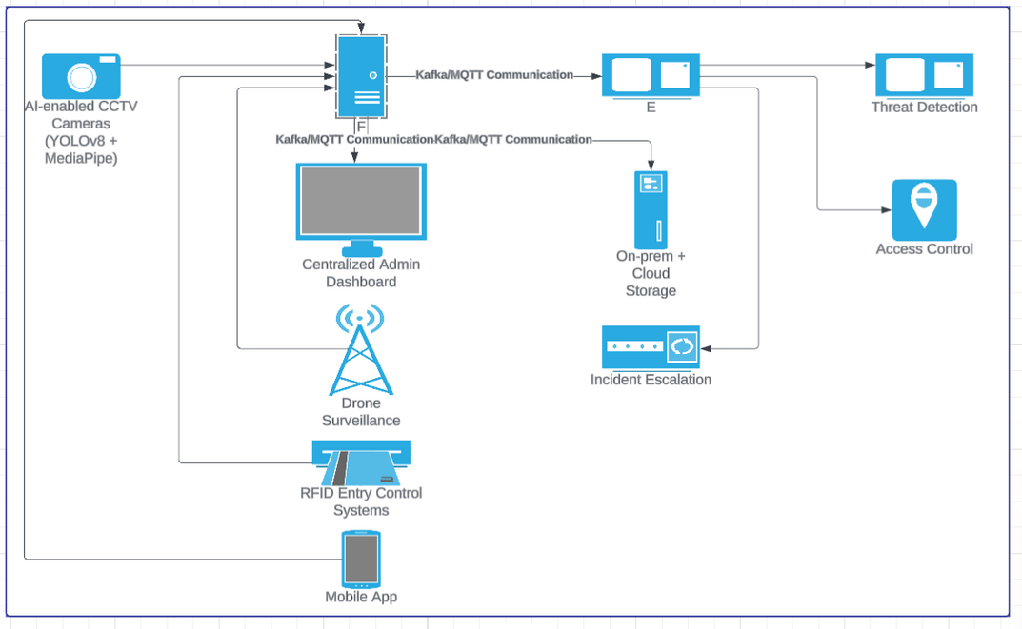
Architecture Diagram
IntelliSafe

Slide 6

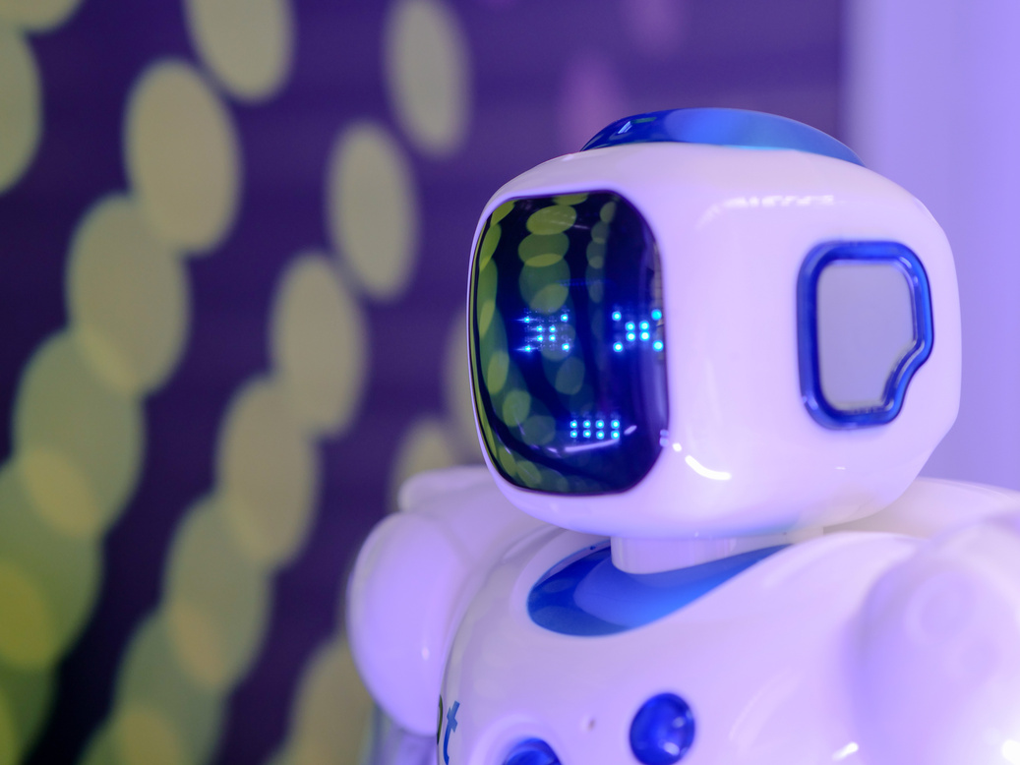

Artificial Intelligence
Core Feature – Object & Behavior Detection
YOLOv8: People, helmets, restricted signs
MediaPipe Pose: Falls, loitering, unsafe postures
DeepSORT Tracking: Assigns persistent IDs across frames
Output:
Bounding-box screenshots
Event metadata (type, timestamp, camera ID)

Slide 7

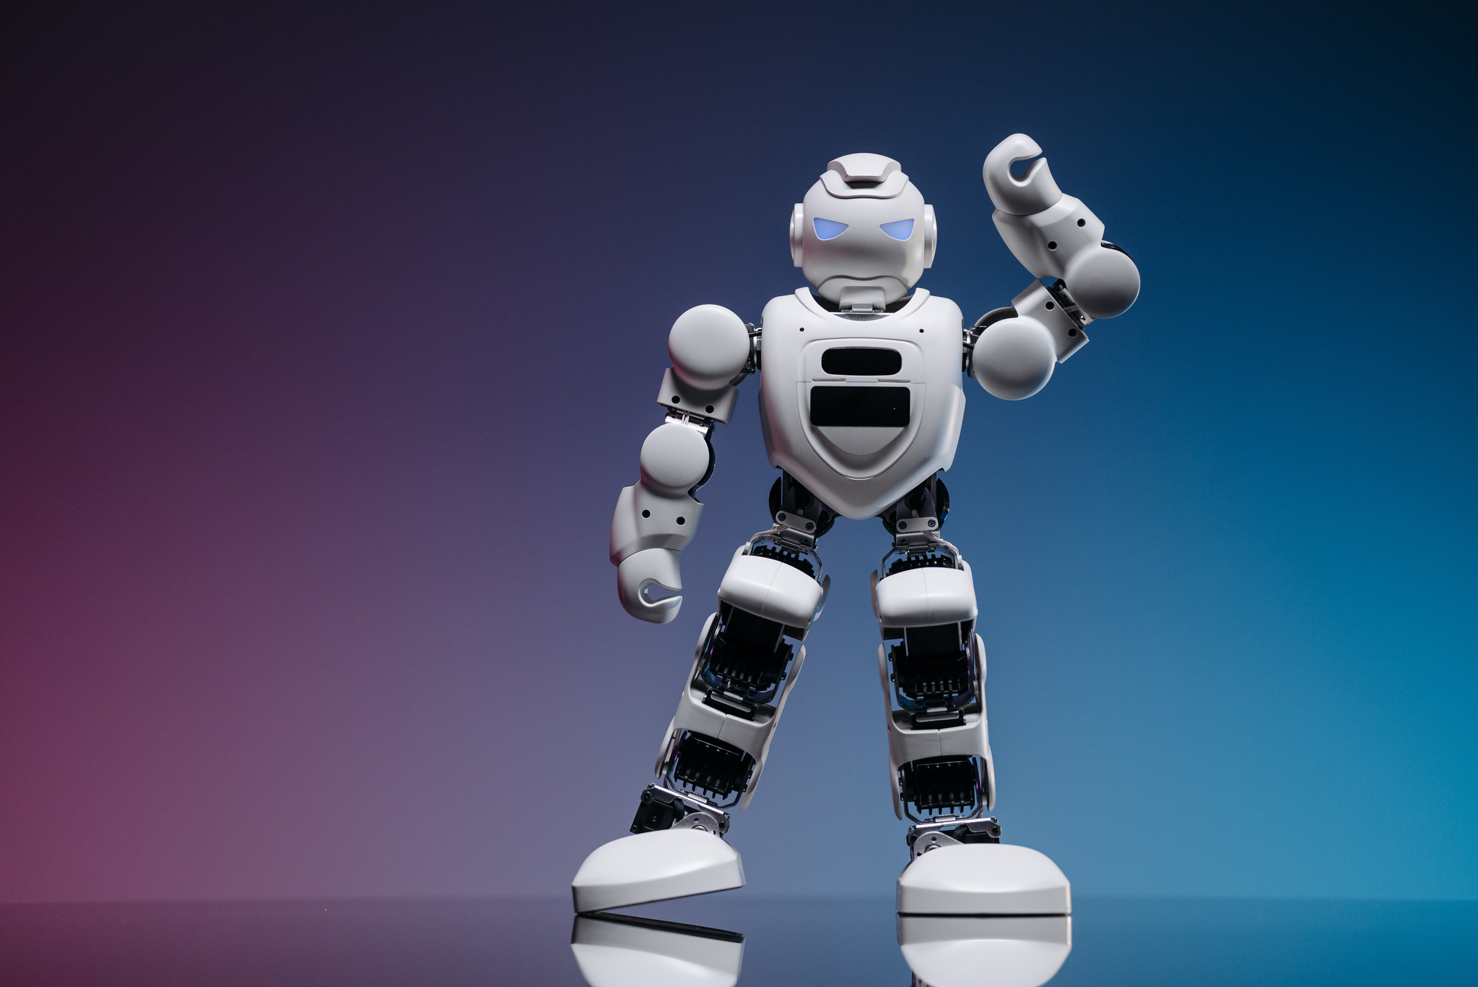
IntelliSafe
Core Feature – Stalker Identification
Logic:
Track every person with DeepSORT IDs
Compute inter-subject proximity each frame
If Person A follows Person B within threshold for ≥20 consecutive frames → flag
Data Stored:
Stalker_ID, Victim_ID, Start_Frame, End_Frame, Camera_ID
Dashboard: “Can-Be-Stalker” list with thumbnails
Let’s gooooo!

Slide 8
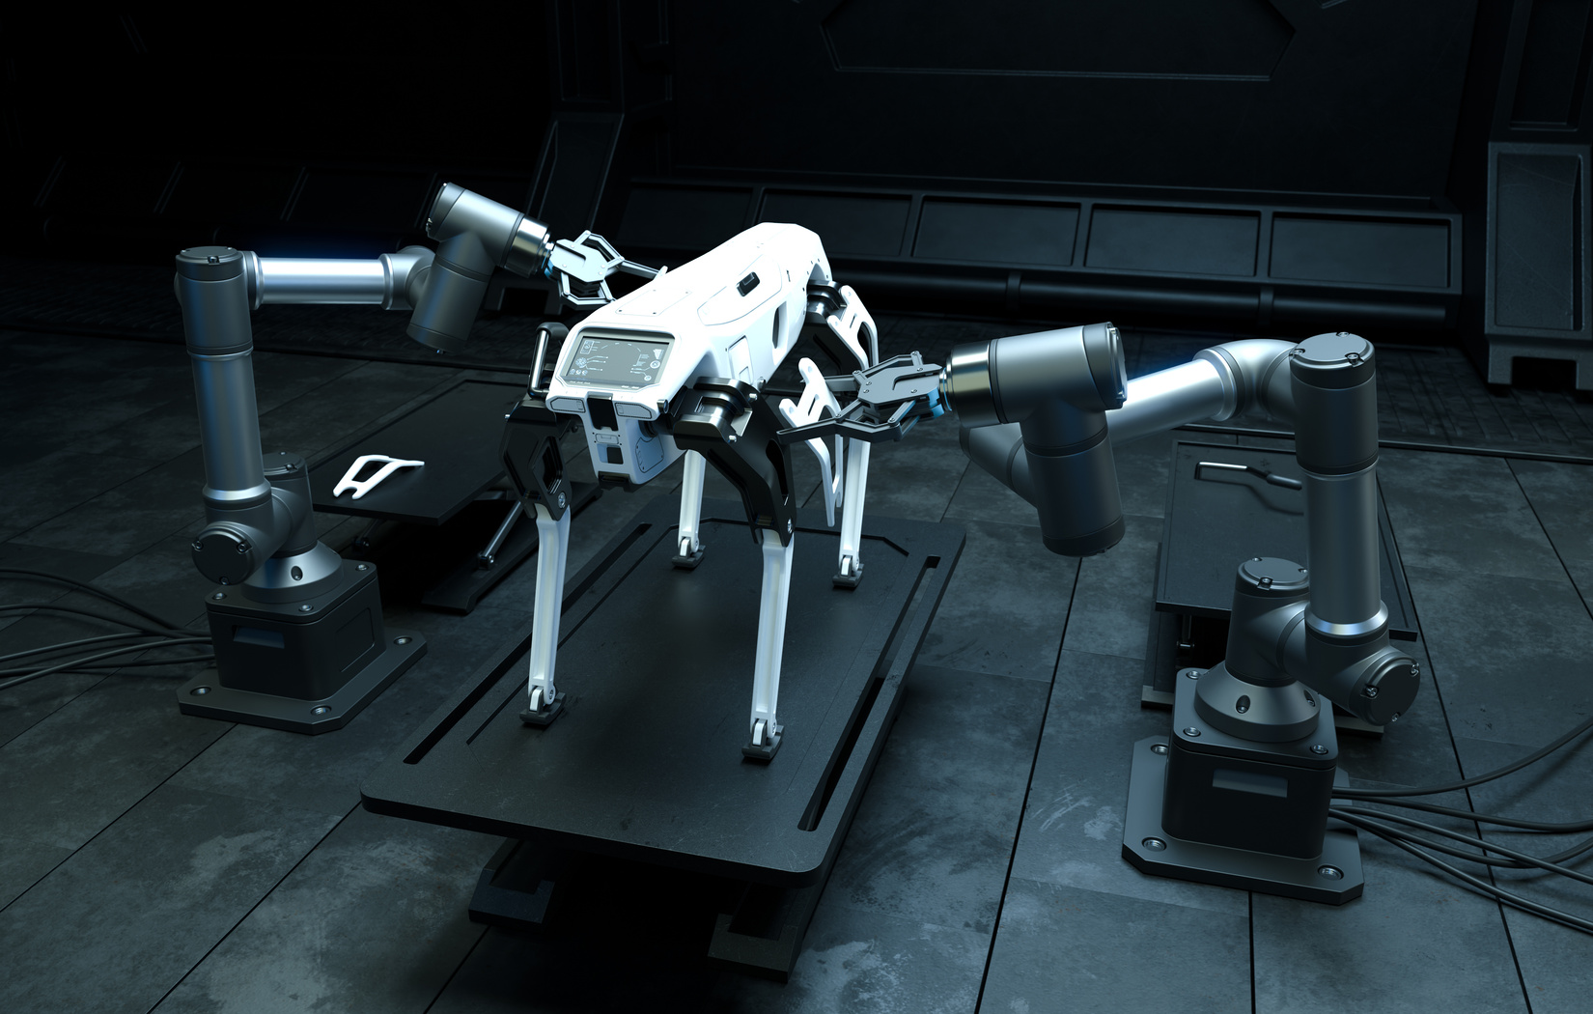
IntelliSafe
Core Feature – Simulated Drone Patrols
Operation:
Sequentially process video segments along waypoints
Generate “Drone Sweep Active” alerts
Dashboard Widget:
Live sweep status
Heatmap overlay of patrol coverage
Controllers
Scheduler: Python cron-style job (18:00–06:00)
Waypoints JSON: Defines campus sweep path

Slide 9



IntelliSafe
Service 1
FastAPI Endpoints: Receive detection events
Queue (Redis optional): Buffers for real-time WebSocket push
Alerting & Logging
Service 2
Dashboard:
Real-time notifications
Clickable thumbnail → full screenshot + metadata
Search Presentation

Slide 10
IntelliSafe
Dashboard & UX Innovations
Real-Time Feed: Live annotated video
Gamification:
“Stalker Risk Score” leaderboard
Badges for correctly confirmed alerts
Map Overlay: 2D campus floorplan with patrol paths & event markers
Manual Feedback: Confirm/Dismiss stalker flags to refine models
Search Presentation

Slide 11
IntelliSafe
Technology Stack
Language & Frameworks: Python 3.9+, FastAPI, React.js, Socket.IO
AI & CV Libraries: YOLOv8 (PyTorch), MediaPipe, DeepSORT, OpenCV
Data Storage: SQLite, local file system
Containerization: Docker (modular microservices)
Optional: Redis for event queue
Search Presentation

Slide 12
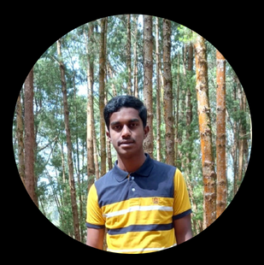
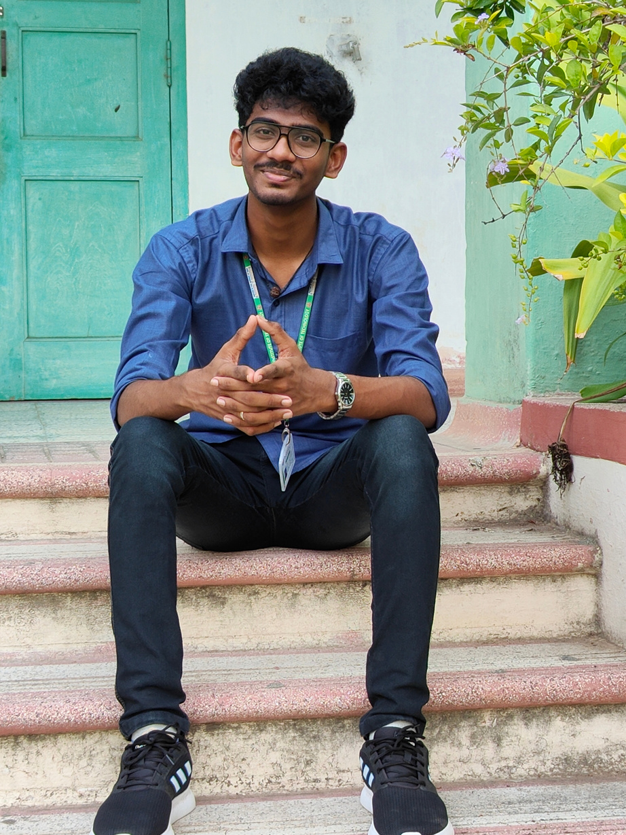
IntelliSafe
Meet Our Team
Balamurali S R
Harish Vardhan D

Slide 13
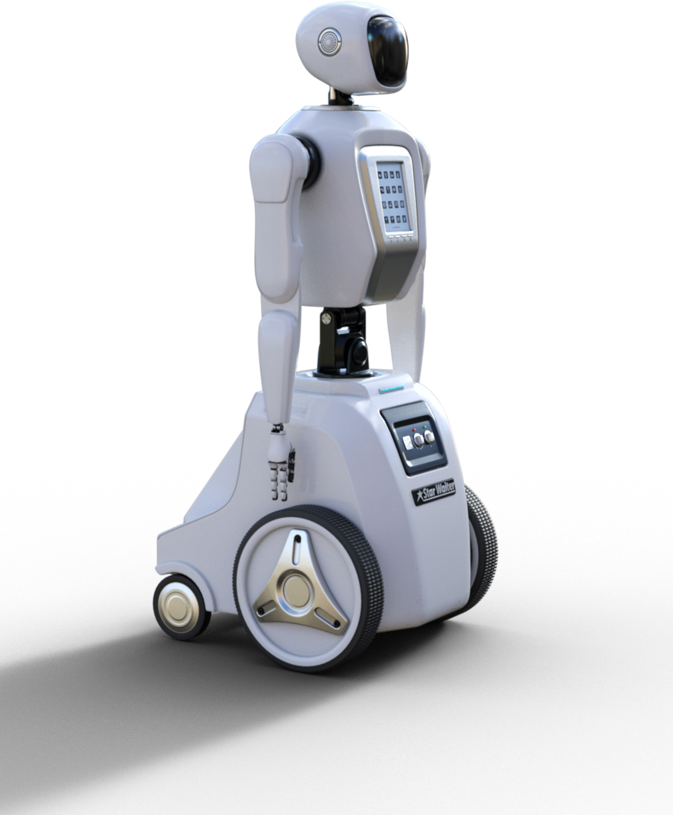
Artificial Intelligence
Thank You
End of Slide

